Slide 1
Breaking the Bottleneck: From Fast Programs to Fast Projects
Craig Savage, PhD, MBA
Sydney Users of R Forum (SURF)
13 November 2019

Slide 2
Disclosures
Before we begin

Slide 3
Personal Introduction
Education in technical fields and business
PhD in Electrical Engineering and MBA
Over 20 years experience in industry:
Defence
Biomedical Engineering
Banking (Risk)
Motivated by implementation of systems
Flight tests
Patient trials
Customer assessment
Goal is to have a measurable impact

Slide 4

Goals
Primary audience: Beginning Data Scientists/R Users
Overview of my experiences and insights
“Wise men learn from others’ mistakes, fools from their own.”
Open source tools, freely available data so that you can reproduce results
Updates since first version of this talk (January 2017, Melbourne)
Provide recommendations
“Actionable Insights”

Slide 5
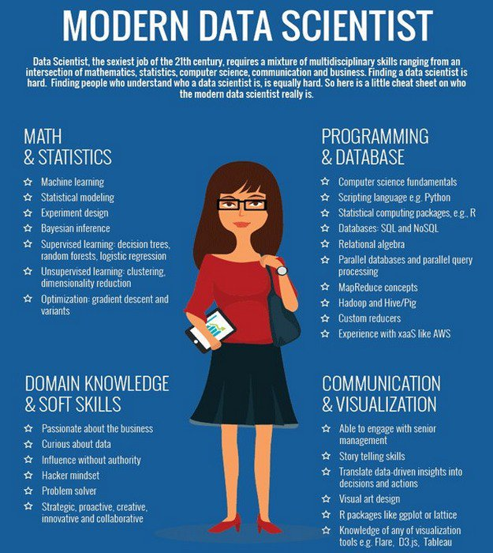
Introduction: Data Scientists
“Sexiest job of the 21st Century”
Four Pillars:
Math & Stats
Programming & Database
Domain & Soft Skills
Communication & Visualisation
Circa May, 2017

Slide 6
Problem Assumptions
Classification/Regression problems
Clear independent/dependent variables
CSV-style data (i.e. not images)
Not “Big Data”
Feasible to run on my laptop
Or runs in the cloud in “near real time” (TBD)
Large organisations
Multiple stakeholders, teams, metrics
Governance
Political
Political Survey:
Who has the power?
How accessible are they?

Slide 7
Example problem: Predict median house prices
Data provided: Boston data set from MASS package
Use linear regression or a random forest
Compare performance with a variety of metrics
Deliverables:
Recommendation
Code for solution
Documentation of results
Slides summarising results
12-week project

Slide 8
Example Problem: Overview
Define
Do
Decide
Done!
Document
Problem statement
Scope
Deliverables
Timeline
Source Data
Write/Test Code
Report to management
Technical document
Slides
Confirm solution
Summary report

Slide 9
Example Problem: Overview
Define
Do
Decide
Done!
Document
Problem statement
Scope
Deliverables
Timeline
Source Data
Write/Test Code
Report to management
Technical document
Slides
Confirm solution
Summary report
✓
✓
✓
✓
✓

Slide 10

Do: Explore data
Data dictionary!
Sample has no missing values!
Write code
Code written in ~ a day!
Code runs in seconds!
Writing up: ~ 45 minutes
Update from previous:
Tidymodels (2018)
dplyr: New to me (had been base R)

Slide 11

Decide: Meeting with Manager
Great Work!
I don’t know how we’ll measure NO₂. Do you know how we’d measure that?
Looks good – but remove the dependence on NO₂.

Slide 12
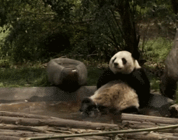
Do (Again!): Modify Code
Need to change a few lines of code, < 1 minute
Simplified with tidymodels: Update recipe
Takes less than a minute to run.
Refresh graphs and numbers, ~15 minutes.

Slide 13
Do (Again!): Modify Code
Need to change a few lines of code, < 1 minute
Simplified with tidymodels: Update recipe
Takes less than a minute to run.
Refresh graphs and numbers, ~15 minutes.
Cumulative:
Coding: ~ 8 hrs
Code Execution: < 1 min
Documentation: ~ 1 hr
Project: 4 weeks…

Slide 14

Decide (Again!): Meeting with Manager
Great Work!
It’s important we utilise all available information. Include the NO₂ levels in the model.
Back to square 1…
Coding: ~ 8 hrs
Code Execution: ~ 1 min
Documentation: ~1.25 hrs
Project: 6 weeks…

Slide 15
Example Problem: Overview
Define
Do
Decide
Done!
Document
Problem statement
Scope
Deliverables
Timeline
Source Data
Write/Test Code
Report to management
Technical document
Summary document
Confirm solution
Summary report
✓
✓
✓
✓
✓
✓
✗
✓
✓
Deciding is the bottleneck___

Slide 16
Real-time Feedback Demo
Using shiny

Slide 17
Overview: Revisited
Define
Do
Decide
Document
Done!
Problem statement
Deliverables
Scope
Timeline
Source Data
Write/Test Code
Summary report
✓
Report to management
Confirm solution
Technical document
Slides
✓
✓
✓
✓
✓
✓
✗
✗
✓
✓
✓
✓

Slide 18
Knowledge Management Demo
Using rmarkdown

Slide 19
Conclusion: Data Scientists
Evolution of definition (IMHO)
Emphasis on Math, Stats, Programming, Database
Tools in Programming, Database, Visualisation
My challenges are in Domain Knowledge, Soft Skills and Communication
Gap: Soft Skills, Communication
Domain Knowledge is specialised:
learn it when you get there!
Tools
Emphasis
Need

Slide 20
Conclusion: Recommendations
Skills:
Negotiations
UX (HTML, CSS, JS)
Typing

Slide 21
Conclusion: Recommendations
Skills:
Negotiations
UX (HTML, CSS, JS)
Typing
Processes
Microsoft Teams Data Science Process

Slide 22
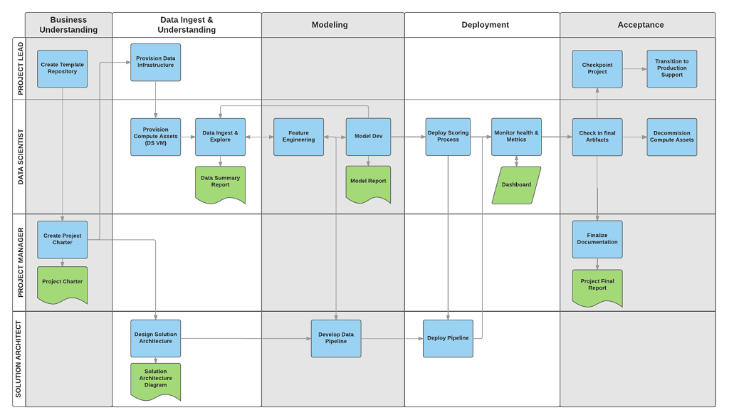
Conclusion: Recommendations
Skills:
Negotiations
Presentations
Typing
Processes
Microsoft Teams Data Science Process
CRISP-DM
https://docs.microsoft.com/en-us/azure/machine-learning/team-data-science-process/overview

Slide 23

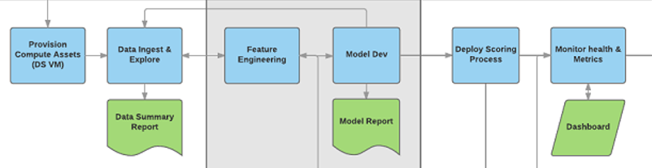






Conclusion: Recommendations
Skills:
Negotiations
Presentations
Typing
Processes
Microsoft Teams Data Science Process
CRISP-DM
https://docs.microsoft.com/en-us/azure/machine-learning/team-data-science-process/overview

Slide 24
Conclusion: Recommendations
Skills:
Negotiations
UX (HTML, CSS, JS)
Typing
Processes
Microsoft Teams Data Science Process
CRISP-DM

Slide 25

Conclusion: Recommendations
Skills:
Negotiations
Presentations
Typing
Processes
Microsoft Teams Data Science Process
CRISP-DM
BY: Kenneth Jensen [CC BY-SA 3.0],
https://upload.wikimedia.org/wikipedia/commons/b/b9/CRISP-DM_Process_Diagram.png

Slide 26
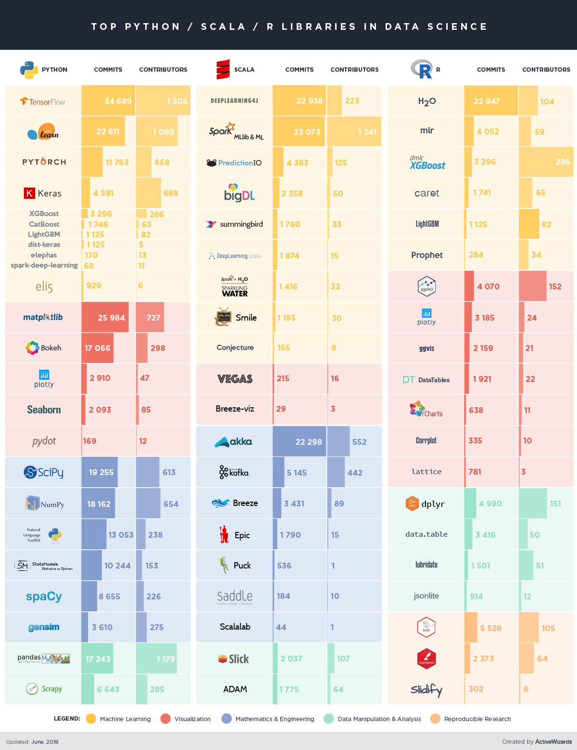
Conclusion: Recommendations
https://activewizards.com/blog/comparison-of-top-data-science-libraries-for-python-r-and-scala-infographic/

Slide 27
Conclusion: Recommendations
Skills:
Negotiations
UX (HTML, CSS, JS)
Typing
Processes
Microsoft Teams Data Science Process
CRISP-DM
Business Acumen
What are the business metrics? Dollars, engagement, etc?
Lean, Agile, Six Sigma, Management by Objectives, Total Quality Management

Slide 28
Conclusion: Recommendations
Skills:
Negotiations
Presentations
Typing
Processes
Microsoft Teams Data Science Process
CRISP-DM
Business Acumen
What are the business metrics? Dollars, engagement, etc?
Lean, Agile, Six Sigma, Management by Objectives, Total Quality Management
Problems aren’t technical,
they’re human

Slide 29
Where you can find me
LinkedIn (Craig Savage)
https://www.linkedin.com/in/craig-doc-savage
YouTube (DocSavage):
https://goo.gl/Mjp6Sc
Kaggle (DocSavage):
https://www.kaggle.com/docsavage
GitHub (SavageDoc)
https://github.com/SavageDoc/

Slide 30
Acknowledgements
Sydney Users of R Forum (SURF)
Hosting this event
Invitation
Giphy.com
So many gifs, so little time….

Slide 31

Acknowledgements
SURF
Hosting this event
Invitation
Giphy.com
So many gifs, so little time….

Slide 32

Thank you
Sydney Users of R Forum (SURF)
Presented by Craig “Doc” Savage

Slide 33
Questions?

